Slide 1

DBMS Project
Inventory management website

Slide 2

ABOUT our Project
Our project will be to manage products entering and leaving godowns, shipping them to places across and monitoring the workers and managing their work assigned. We also connect with the customers with a user friendly interface.

Slide 3
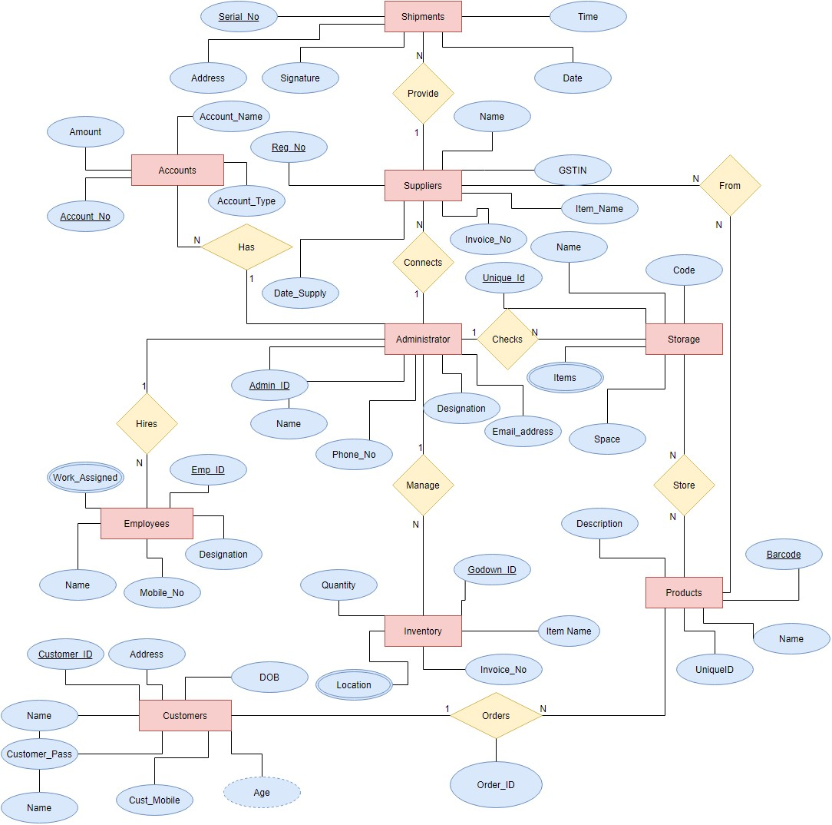
ER DIAGRAM
This is the ER Diagram for our website and our foundation of our website starts.

Slide 4

Components of WEBSITE
Front End (Webpage)
Backend(Oracle and Tables Created)
Connectivity(PHP)

Slide 5
The Front End

Slide 6
The HOMEPAGE

Slide 7
DASHBOARD

Slide 8
ADMIN LOGIN

Slide 9
STAFF LOGIN

Slide 10
CONTACT THE COMPANY

Slide 11
PRODUCT MANAGEMENT

Slide 12
PRODUCT REPORT AND FORM

Slide 13
USER REPORT AND FORM

Slide 14
ORDER REPORT AND NEW ORDER

Slide 15
SUPPLIERS LIST AND NEW SUPPLIER

Slide 16
BACK END TABLES

Slide 17
BACK END TABLES

Slide 18
BACK END TABLES

Slide 19
CONNECTIVITY OF THE SYSTEM

Slide 20
CONNECTIVITY OF THE SYSTEM

Slide 21
CONNECTIVITY OF THE SYSTEM

Slide 22
CONNECTIVITY OF THE SYSTEM

Slide 23
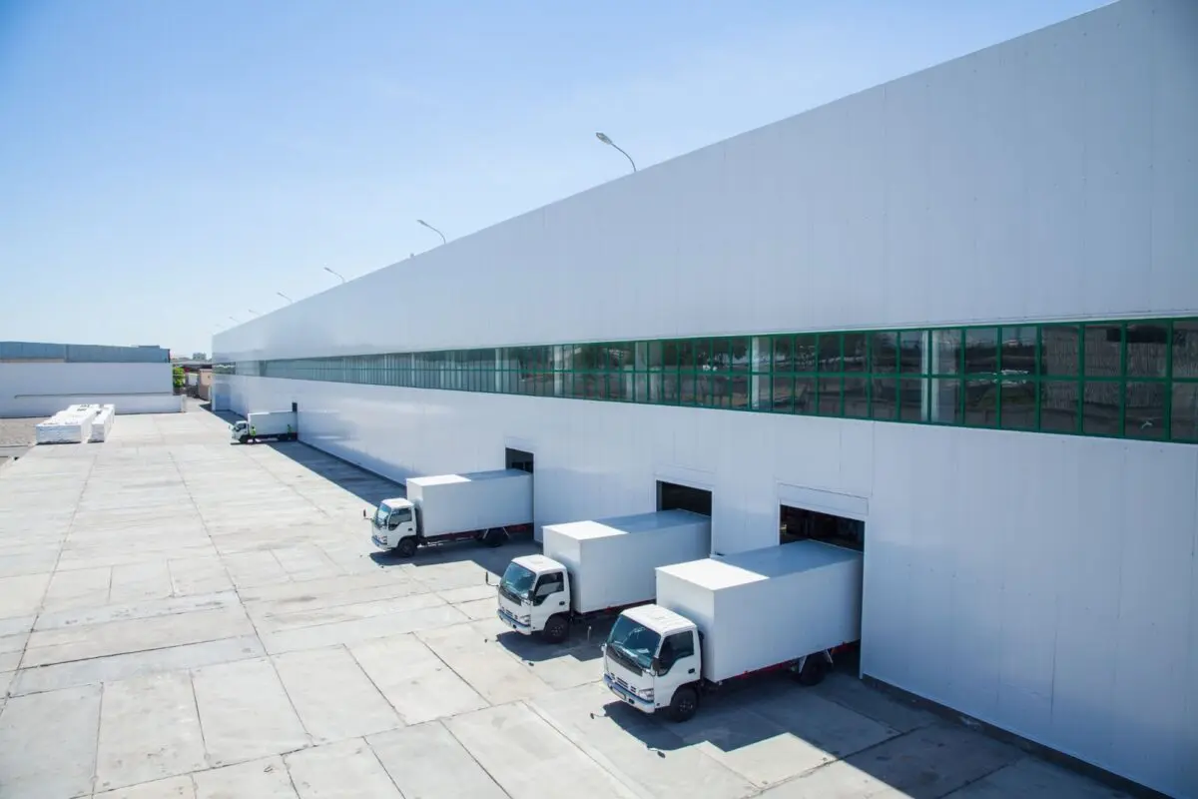
Thank you
Sandeep Raj BL.EN.U4CSE21156
Radha Nishant BL.EN.U4CSE21161
Rejeti Kartik BL.EN.U4CSE21170
Sanjay Baitha BL.EN.U4CSE21185

